Slide 1
Welcome to the presentation on capstone project execution
Weather Forecasting For Farming
TEAM MEMBERS NAME
Bhushan Sapkale
Vaibhav Navghare
Prajakta Lipane
GUIDE :
MRS.A.P.BORLEPWAR

Slide 2
Index
Sr. No. | Title
1 | Abstract
2 | Introduction
3 | Literature Survey
4 | Why We Develop This
5 | Advantages
6 | Application
7 | Requirements
8 | Conclusion
9 | References

Slide 3
Abstract
The main objective was to plan and program a desktop application for agro-employe and Farmers. This application will help many farmers to take good decision for their farm. Thus the application can help the user in farming digitally. Weather forecasting can help with a farmer’s business decisions

Slide 4
introduction
Project Name : Weather Forecasting For Farming
Backend : Xamp
Frontend : Python, Html, Css
Web Browser : Mozilla, Google Chrome

Slide 5
Literature Survey
Problem Statement: weather forecasting will help farmers to plan their many day to day decisions. But in case some farmers can face difficulties in operating smartphones or in understanding other languages than marathi.
Solution: so we decided make a app for agro-centers and agro-shopes.

Slide 6
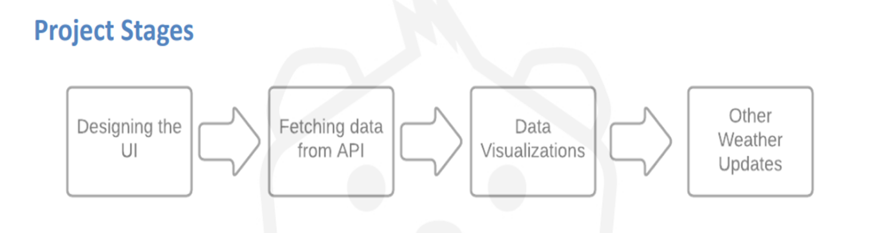

Slide 7
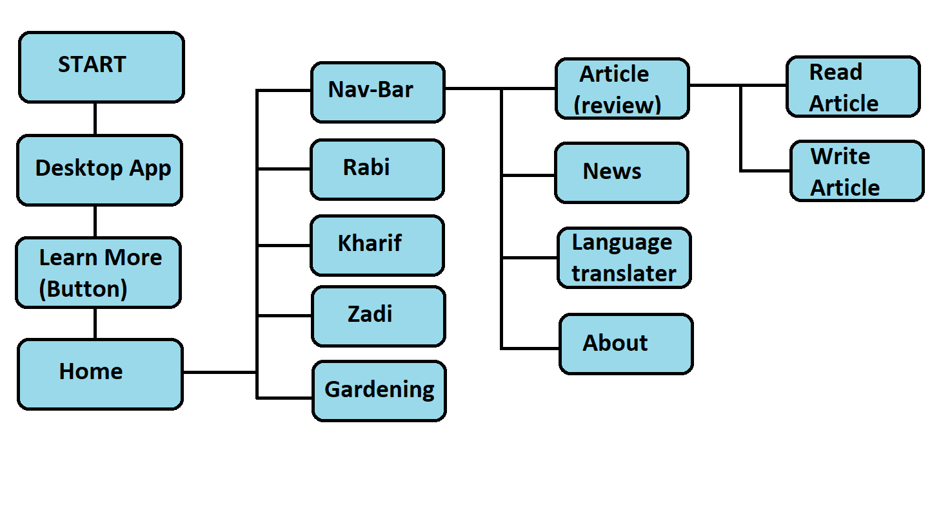
Work Flow

Slide 8
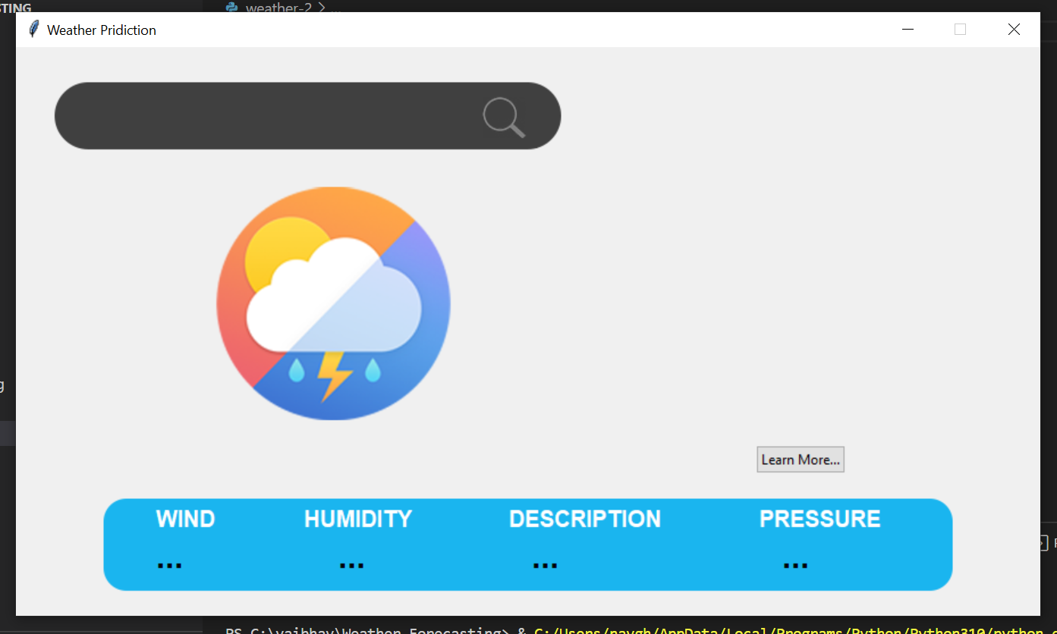

Slide 9
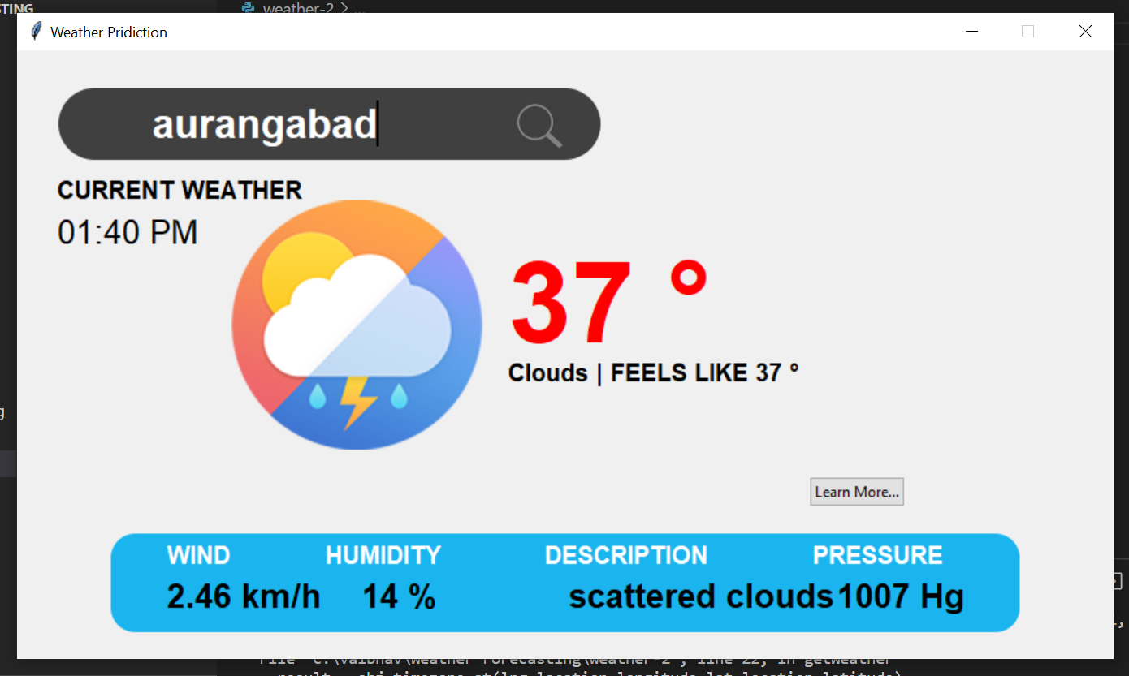

Slide 10
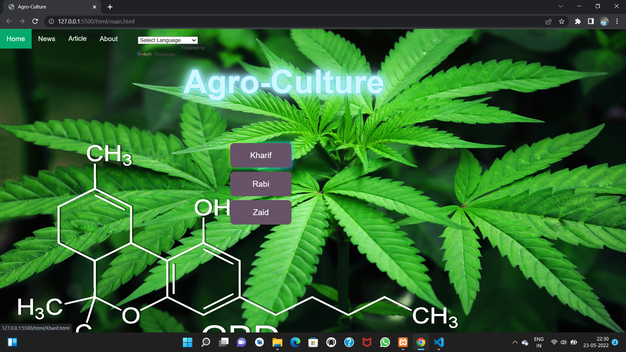

Slide 11
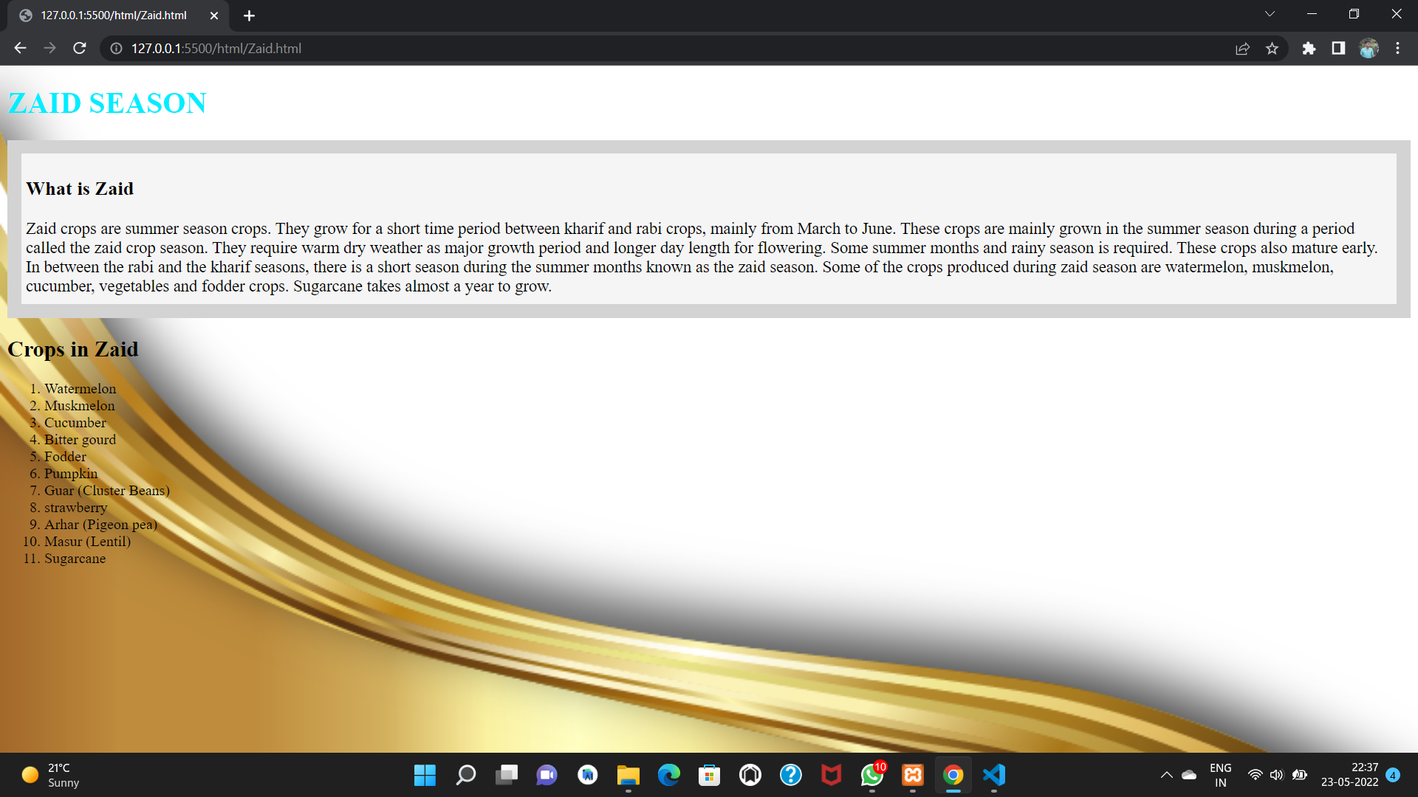

Slide 12
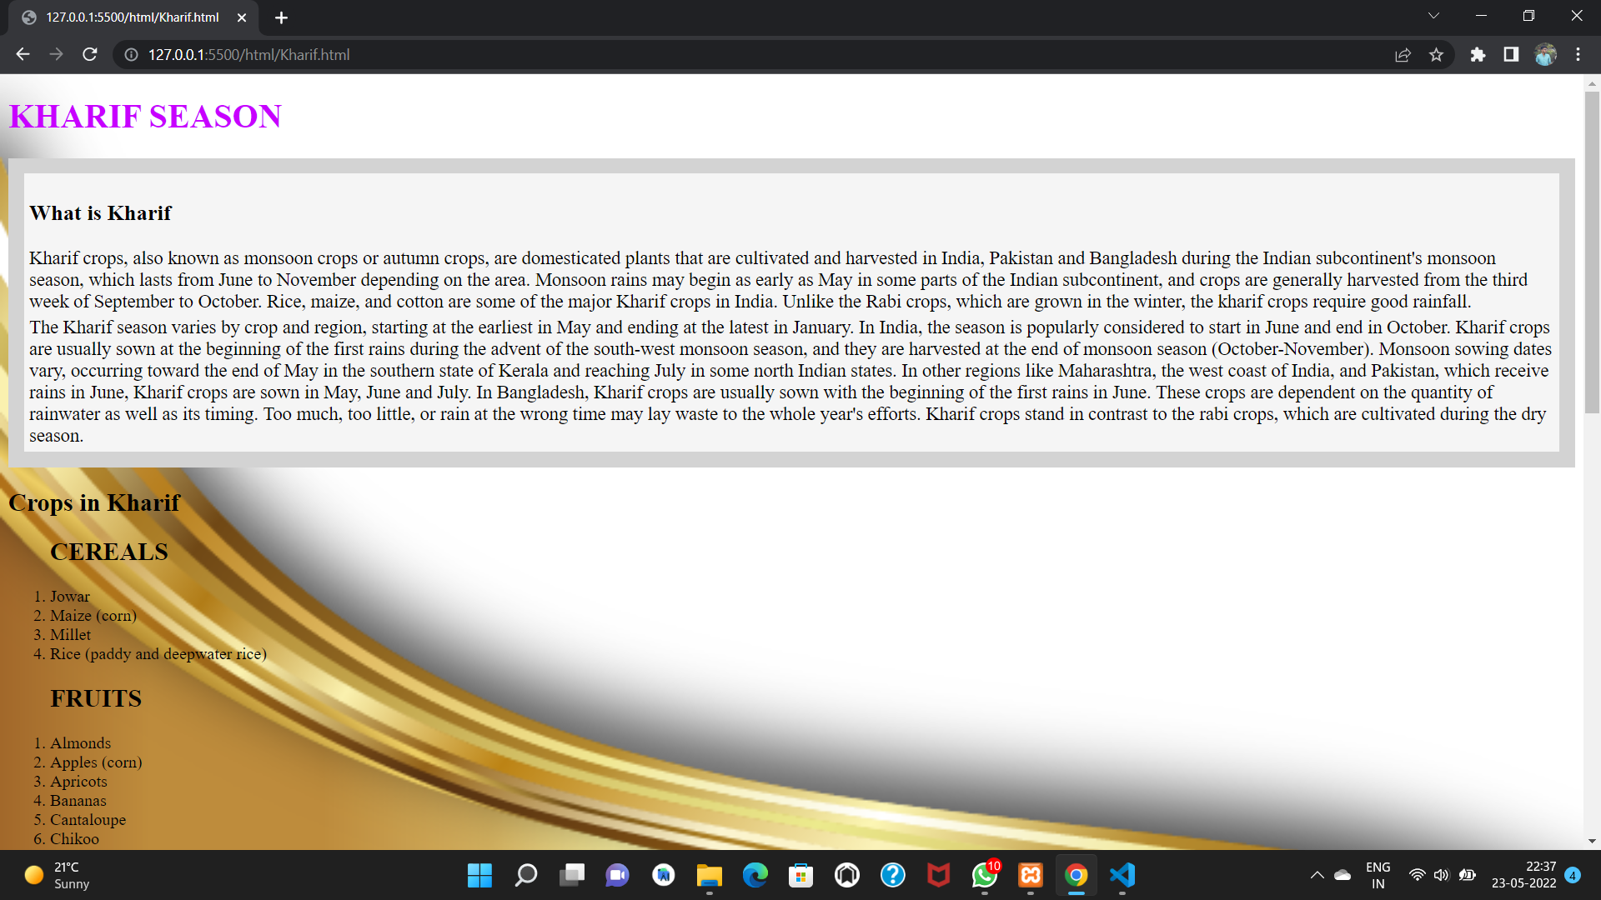

Slide 13
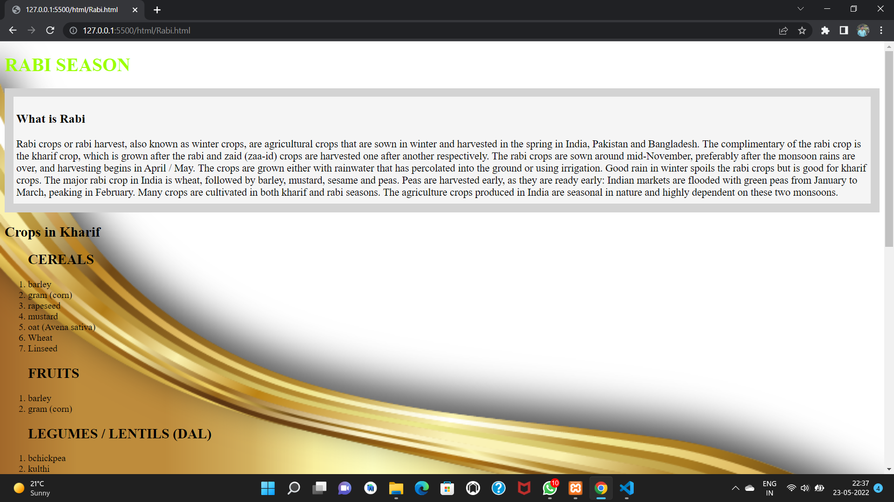

Slide 14
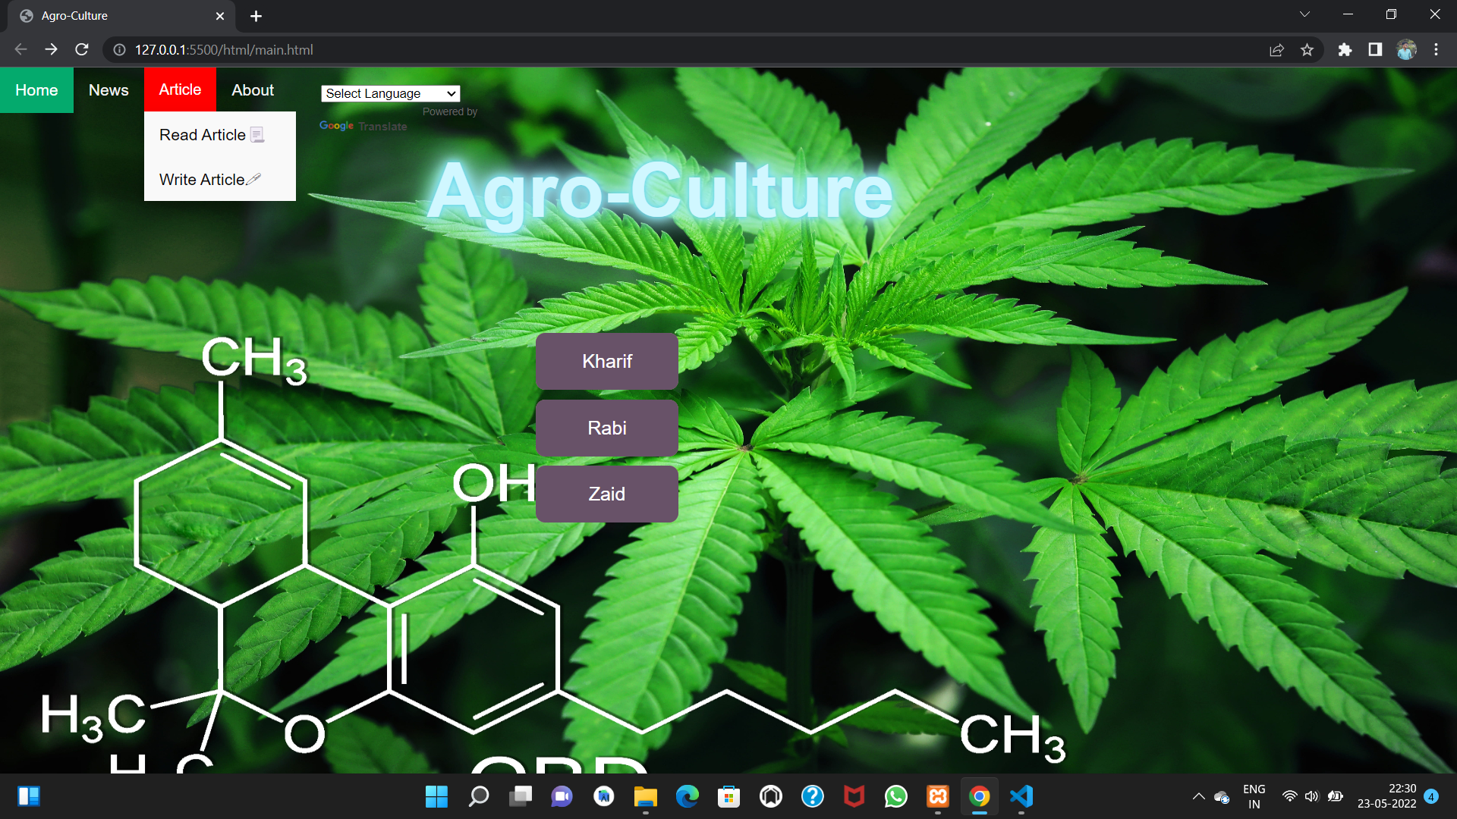

Slide 15
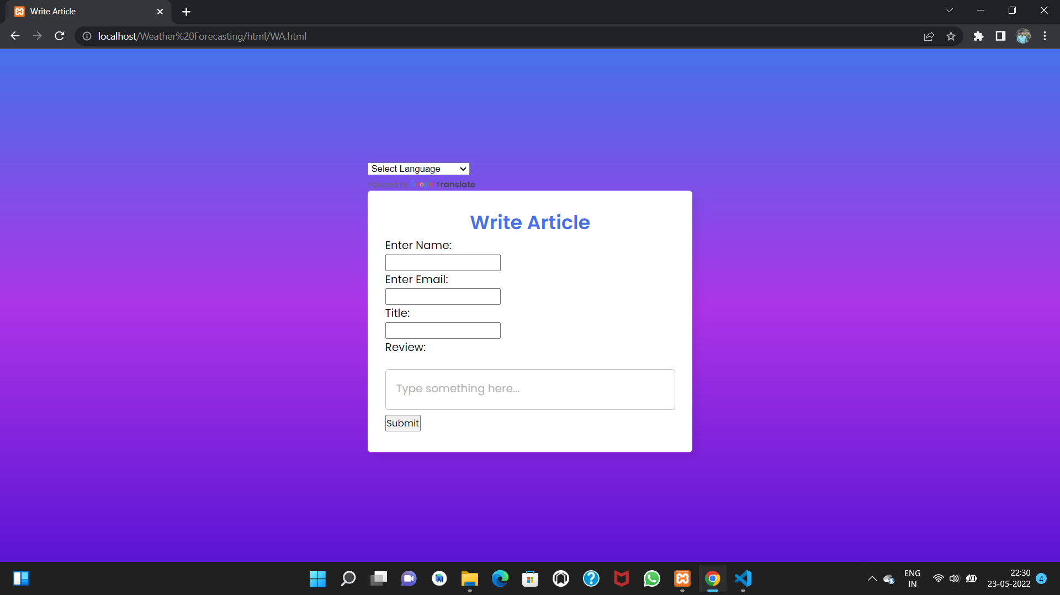

Slide 16
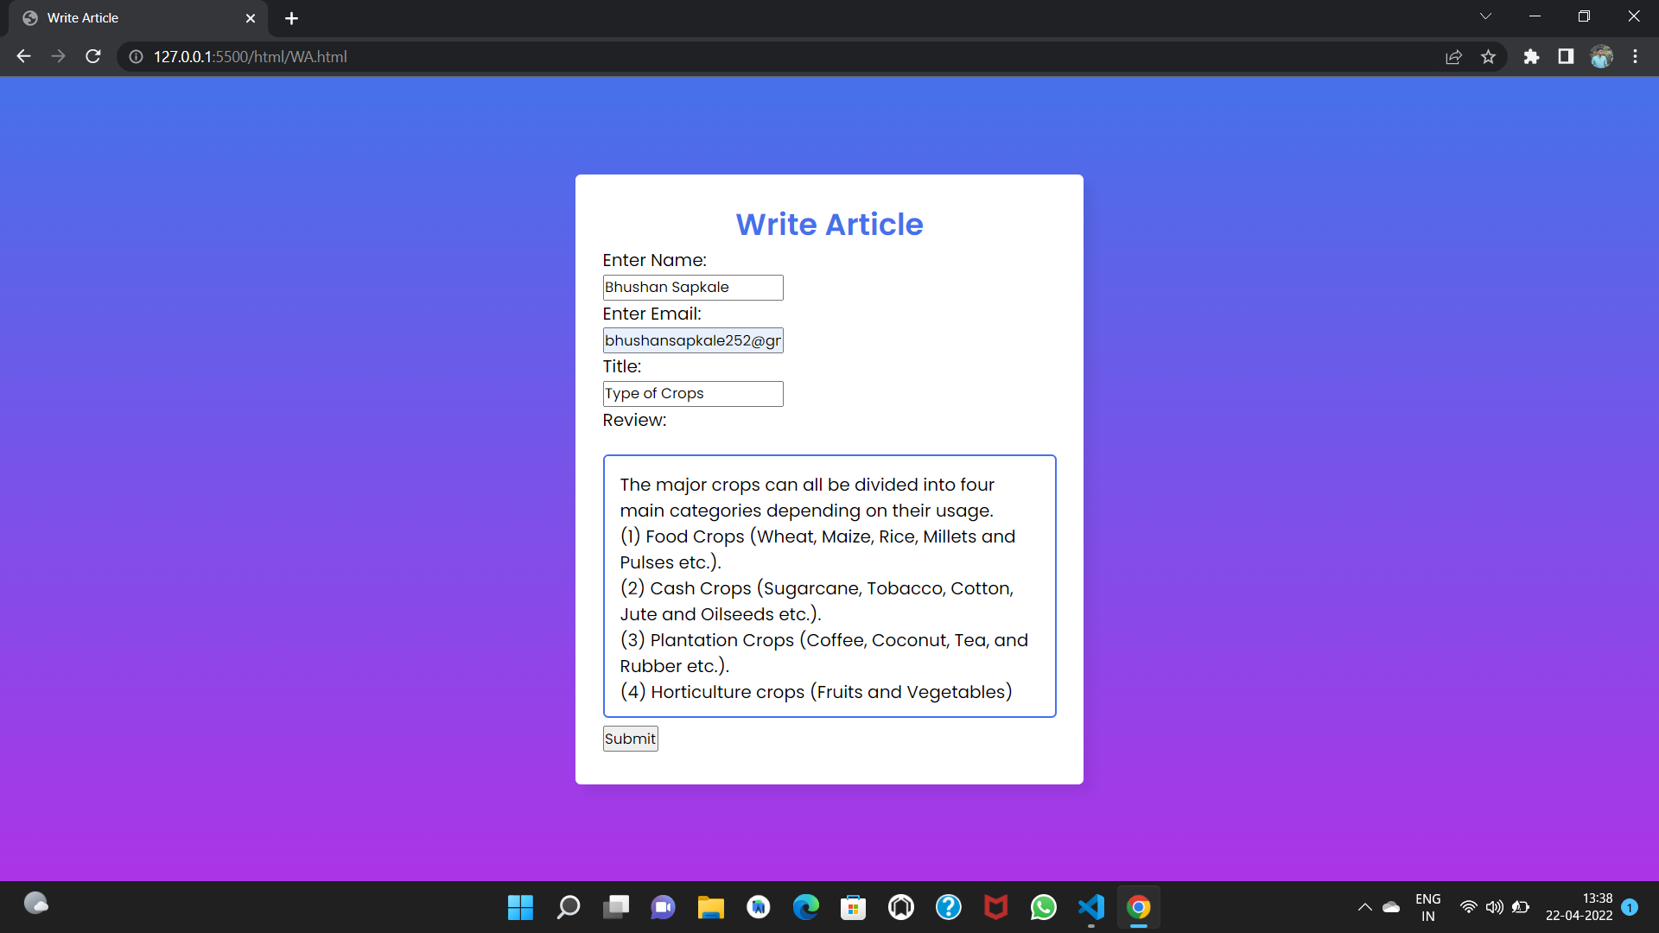

Slide 17
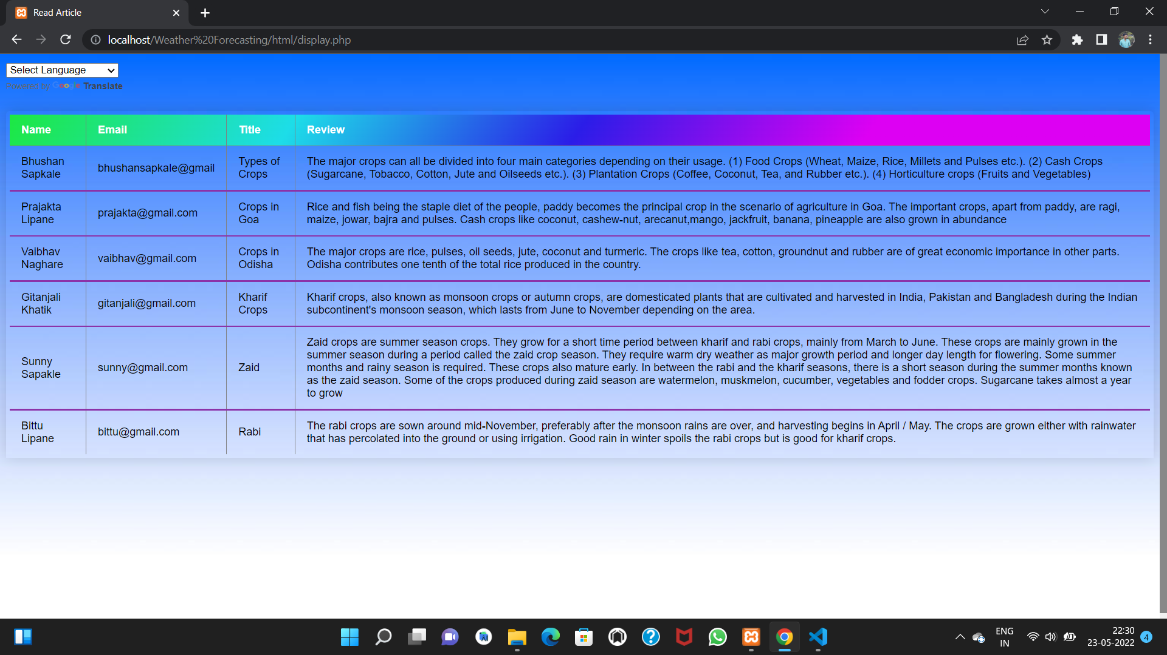

Slide 18
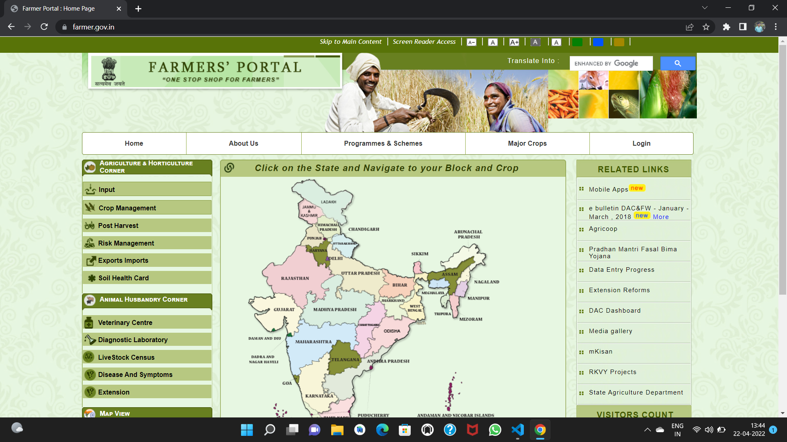

Slide 19
WHY WE DEVELOP THIS..
The main conceptual idea of the Weather Forecasting is based on a application that predicts the weather. This prediction / Weather Forecast Will help farmers to know when to apply the Pests And Chemicals to avoid the crop wastage.

Slide 20
aDVAnTAGES
This will help farmers in agriculture.
It will reduce the weather related losses of farming/crop.
This can help fresh employ at agro-center.

Slide 21
application
We can use this model in Agro-center.
This can be used in many Agro-shopes.
This also can help farmer to learn new technics of farming.

Slide 22
Software Requirements
Frontend: PYTHON, HTML, CSS
Backend: XAMP
Browser: CHROME, MICROSOFT EDGE
Ide: VISUAL STUDIO/PYCHARM.

Slide 23
Hardware Requirements
PROCESSOR: INTELCORE I3 10TH GEN
RAM: 2 GB
HDD: 100 GB HDD
OPERATING SYSTEM: WINDOWS 7

Slide 24
Conclusion
Now a days as technology is evolving from manually working to online working I. Every field. So it has become easy to share our knowledge with each other. This project will help the employe at agro-center to work efficiently and will also fullfil the need of farmers at some extent with this we conclude our project

Slide 25
References
https://agro-center.de/en/home/
https://www.dtn.com/the-role-of-weather-and-weather-forecasting-in-agriculture/
https://tractorguru.in/tractor-blog/importance-of-weather-forecasting-in-modern-agriculture-and-farming
https://geopy.readthedocs.io/en/stable/

Slide 26
Thank You

